Slide 1
Automatic Fire Detection and Prevention System
Welcome to the presentation of my first embedded system project, the "Automatic Fire Detection and Prevention System".
Prepared By :
Shahanur Mahmud Pranto
Roll: 200633
Department Of Information And Communication Engineering
Pabna University Of Science And Technology

Slide 2
Project Details
Project OVERVIEW: An automatic fire detection and prevention System using temperature and smoke sensors to accurately identify fire hazards and using directional water sprayer to suppress and prevent the spread of the fire. The system employs advanced sensors for early fire detection, triggering an automated water sprayer to target and extinguish the fire at its source.
Key Components:
Temperature And Smoke Sensors
Alarm System
Fire Prevention Mechanisms
Microcontroller (Arduino)
User Interface (E.G., LCD Display)

Slide 3
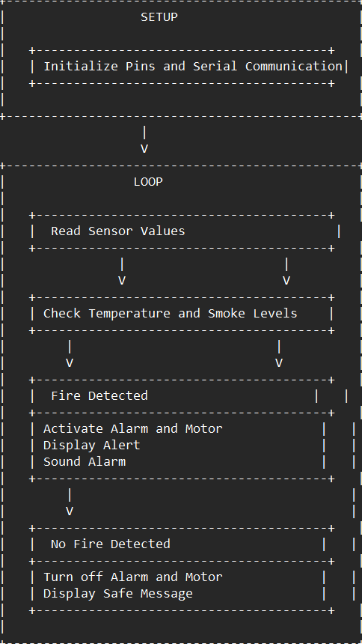
Program Flow Diagram
Flow Chart
SETUP
Initialize Pins and Serial Communication
LOOP
Read Sensor Values
Check Temperature and Smoke Levels
If
Temperature > 49°C or
Smoke density > 10%
Fire Detected
Else
No Fire Detected
Activate Alarm
Active Motor
Display Alert
Sound Alarm
Turn off Alarm
Turn off Motor
Display Safe Message

Slide 4
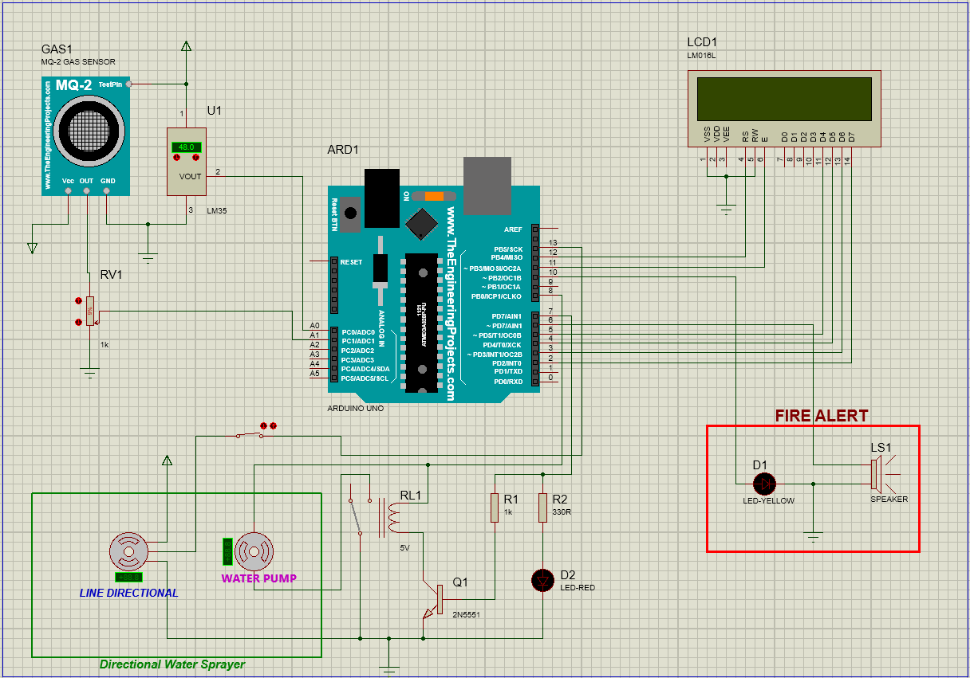
Circuit Diagram (Proteus Simulation)
DEVICES -
MQ-2 GAS SENSOR
LM35
POT-HG
LM016L
2N5551
ARDUINO UNO
MOTOR-DC
MOTOR-PWMSERVO
RESISTOR
RELAY
SPEAKER
SWITCH
LED-RED
LED-YELLOW

Slide 5
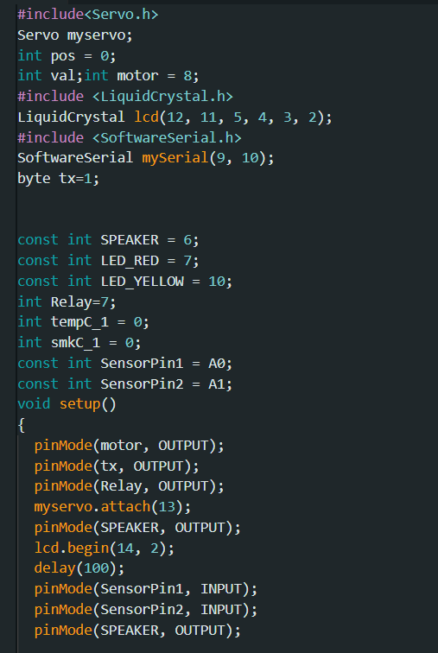
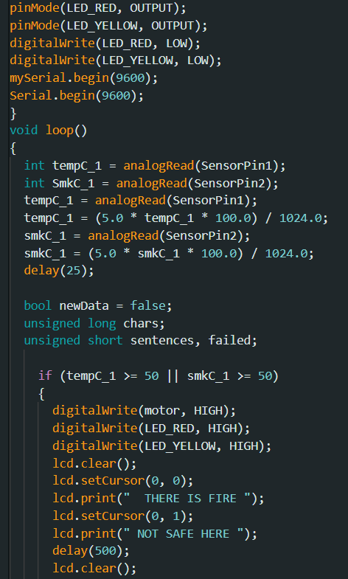
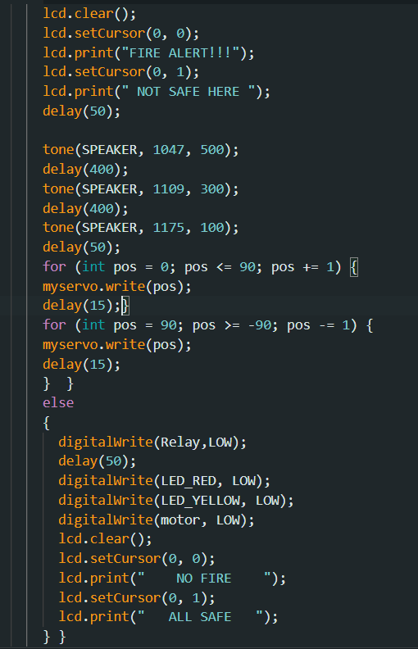
Code

Slide 6
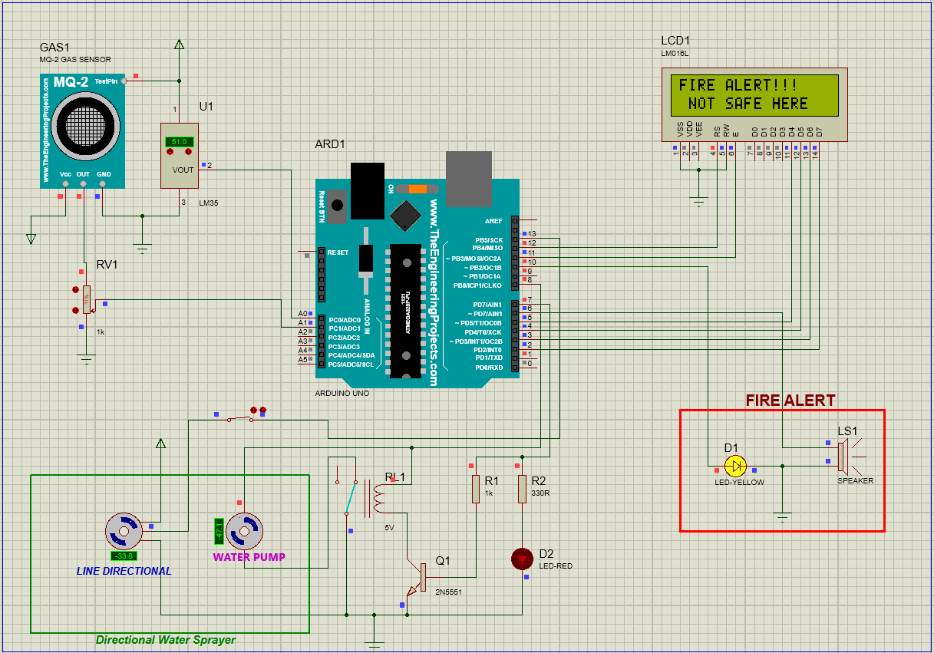

OUTPUT
Fire Detected
No Fire Detected

Slide 7
Thank You Everyone

